Slide 1

Information Theory Analysis of Single Molecule Experiments
Raymond J Park
4th year Chemical Engineering Student
University of Texas at Austin
Advised by Dr. Dmitrii E. Makarov

Slide 2
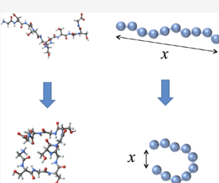
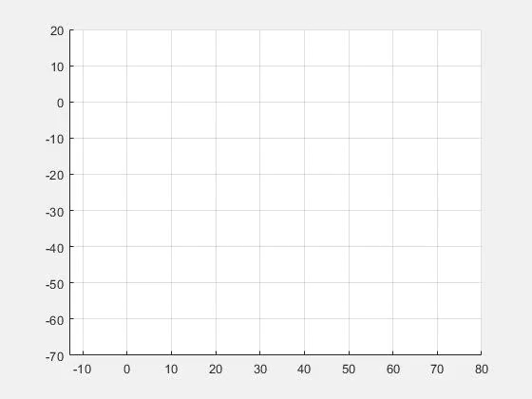

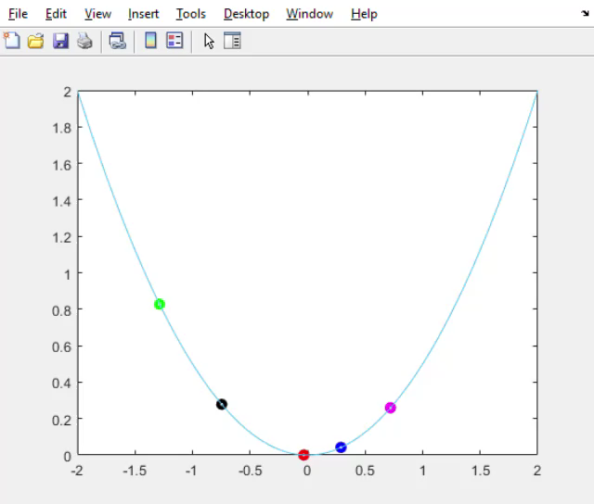
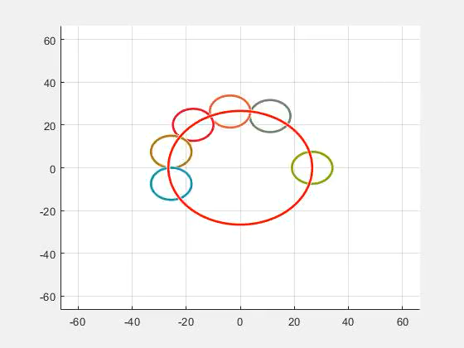
1
2D Self-Avoiding Random Walk
Problem Outline
Research on single molecule has been extensively performed.
E2E distance of polymer chains
Protein folding
Low experimental time resolution
Markov Dynamics? (Inverse problem)
Projection of Multidimensional system leads to Non-Markov dynamics
Memory Kernel from Generalized Langevin Equation (GLE)
Transition path times
Anomalous diffusion
Single File (Parabolic)
Single File (Periodic)
¹ Rohit Satija, Atanu Das, Steffen Mühle, Jörg Enderlein, and Dmitrii E. Makarov
The Journal of Physical Chemistry B 2020 124 (17), 3482-3493
DOI: 10.1021/acs.jpcb.0c01437
Notes:
The problem we are considering is wht sort of model can we use to describe a particles motion? There are many research topics, especially in the biomolecular research that explores this. These include E2E distance of polymner chains such as DNA, and protein folding.
One of the difficulties of extracting valuable information of the mechanism of biomolecular system is the low experimental time resolution. Extracting and simulating the conditions of molecules are incredibly hard. It may take several day and even weeks to create a trajectory with enough data that can be analyzed.
With these in mind, we desire to aask ourself this question: Given a trajectory, can wee determine if purely Browian motion, or moves with some form of memory? In much of our simulation, we strictly perform a 1-D system that mimics the multidimensionality of real biological system. But this has shown to lead to non-Markov dynamics
We can also fit a GLE to extract the memory kernel of the system. We can also lok at transition times and look at the mean square displacement of the particle. But many system has shown similar characterstics that have shown to be Markov and non-makrov.

Slide 3
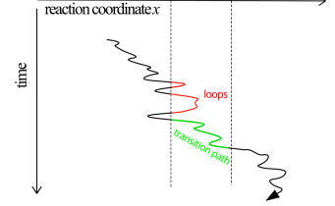
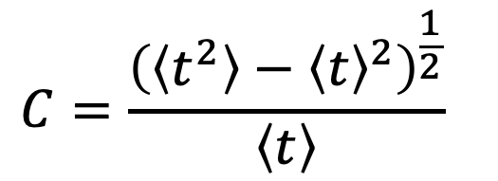
Anomalous Diffusion
Non-Exponential relaxation
Transition path times
$$C=\frac{{\left(\left\langle t^{2}\right\rangle −{\left\langle t\right\rangle }^{2}\right)}^{\frac{1}{2}}}{\left\langle t\right\rangle }$$
Coefficient of Variation
Notes:
There are many tests that be performed to quanity how much memory even if it exists in a system. Coefficient of varaiton, which is the ratio between the standard deviation of the transition times to the mean of the transition times can be calculated. The C values indicates how broad the distribution of the transition paths are. No 1D dimensional model can have a coefficient of variation that exceeds one. This has been extensively proven. A C value that is greater than 1 is an indication of multidiemsnailty in the dynamics, though a C value less than 1 does not necessarily mean that the dynamic is 1D.
So, in this presentation, we present to you information based analysis of single molecular trajectory using lossless compression algorthim.

Slide 4
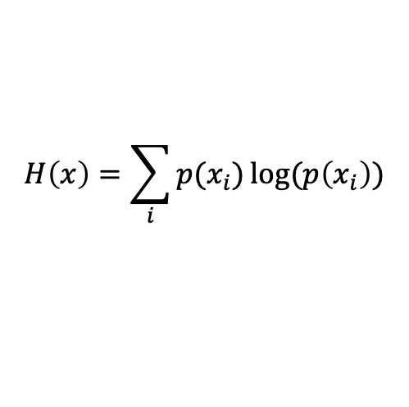
Information Theory
Proposed by Claude Shannon
Key understanding is ”surprise” or new information gained
Given a fair coin, what outcome can we expect?
$$H\left(x\right)=\sum_{i}{{p(x}_{i})}log⁡(p\left(x_{i}\right))$$
Entropy:
We can use this to distinguish non-Markov and Markov process
Notes:
IN 1948, Shannon proposed that information is a measurable quantity. Similar to his work with the printed eenglish text. Due to thee natur eof our language, and rules. For example, there must be vowels in words or the letter e must before letter I, becomes. Restrictions which decreases the surprise or information in a English text. This is the whole concept of information theory. The quantitative calculation is called entropy as defined as follows. It s aausmmtion across ll observables. So, for a non-Markov process, where a process is completely random, we will see less surprises since we can predict the path of a particle since it moves with some sort of memory. Here on the right, shows a coin toss. Obviously, when the coin is far, we see more surprise since it’s at max uncertainity, so the entropy is greatest.

Slide 5
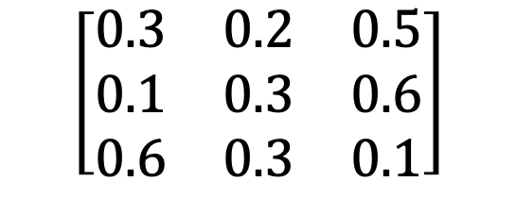
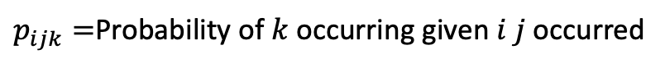
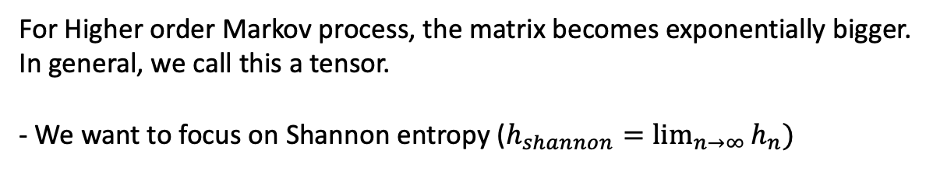
Wind
k^{th} order Markov Process
B
Rain
Cloud
Markov process is better explained as follows:
“If it rains today, what’s the probability of raining tomorrow?”
A
C
For Higher order processes, the dimensions of our matrix increases
A
B
C
$$\left[\begin{matrix}0.3 & 0.2 & 0.5 \\ 0.1 & 0.3 & 0.6 \\ 0.6 & 0.3 & 0.1\end{matrix}\right]$$
A
$p_{ijk}=$Probability of $k$ occurring given $i j$occurred
B
C
For Higher order Markov process, the matrix becomes exponentially bigger.
In general, we call this a tensor.
- We want to focus on Shannon entropy ($h_{shannon}=\lim_{n→∞}{h_{n})}$
1st Order Transition Probability Matrix
Notes:
The most commonly used explaintion of Markov process is weather. Essentially, a Markov process is a process where the present state is only determined by its past initial state. For the example, the key word is “tomorrow.” More mathematically, we can used tensor matrix to describe our probabailities in case of many different events possible. Fro example, cloudiness? Rain? Sunshine? Windy?
What hppens if we want to the probability its raining given that it rained for the past two days, not necessarily, the last day? This is a 2nd order process since there are two events at play. Our matrix becomes quite big since we need to consider all possibilities of events. Using this matrix, this allows us to calculate the kth order entropy rate. What’s the information gained per step if we know some k number of string of characters beforehand!
Shannon entropy is the absolutel limit of entropy calculations. It’s the limit if we know infinite number of symbols, what’s the absolute best aaamount of information we can know aabout the next symbol!

Slide 6
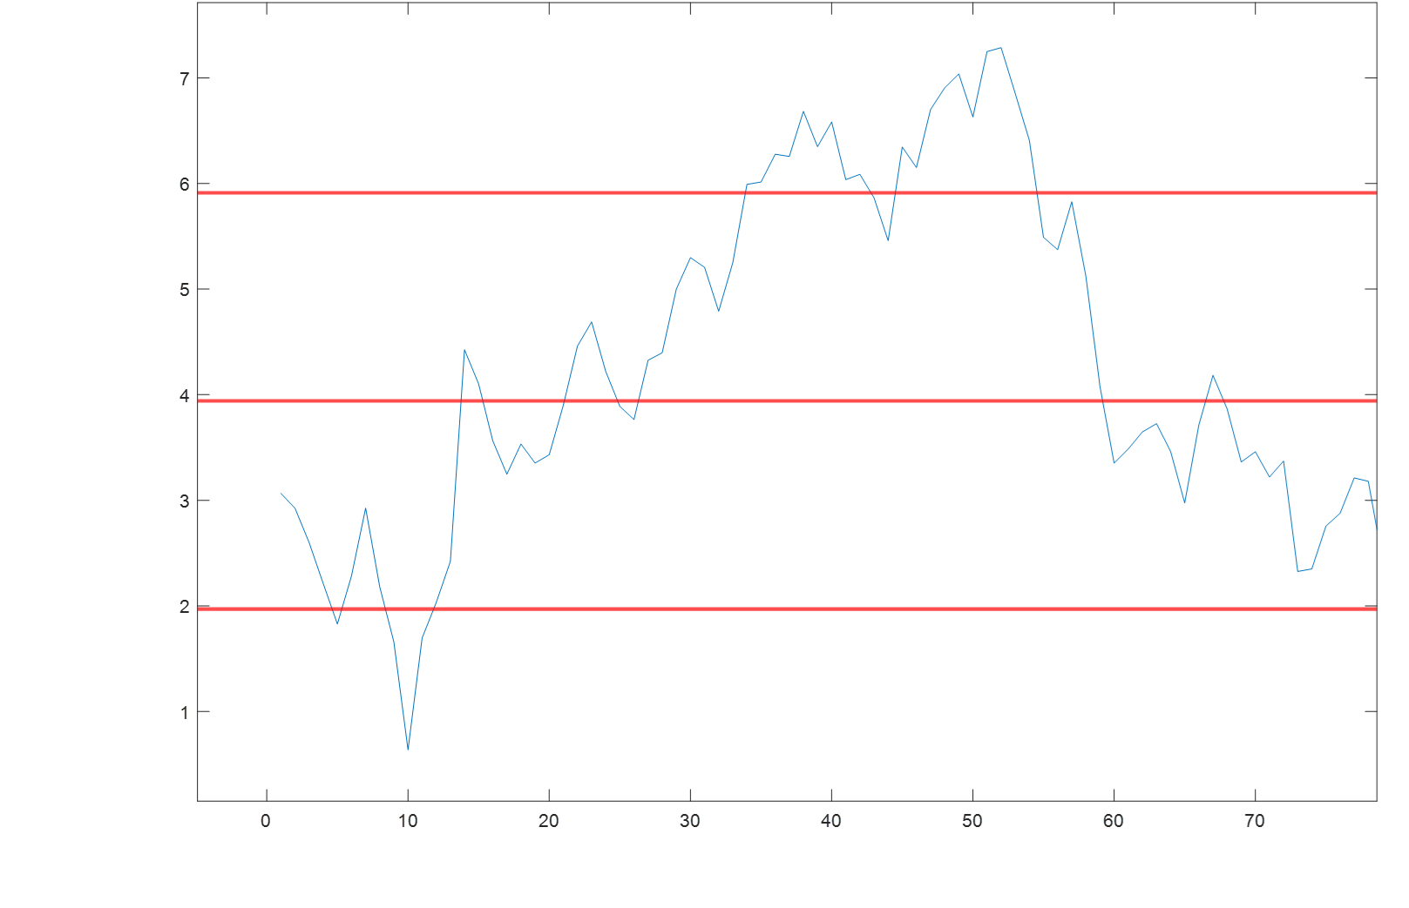
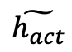
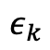
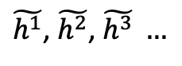
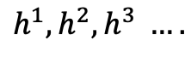
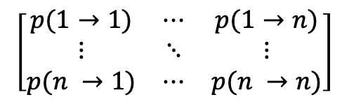
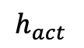
Procedure
$$\left[\begin{matrix}p(1→1) & ⋯ & p(1→n) \\ ⋮ & ⋱ & ⋮ \\ p(n →1) & ⋯ & p(n →n)\end{matrix}\right]$$
$$h^{1}, h^{2}, h^{3} ….$$
Milestone the actual continuous trajectory
Calculate k^{th} order H/step rate based on histogram values
Numerically simulate k^{th} order Markovian process
Compress the milestone sequence
Calculate compression error
Histogram Entropy rate
Tensor matrix
12123…
3
Simulated k^{th} Process
2
1232…
Milestoned Traj
$$ε_{k}$$
1
$\tilde{h^{1}}$, $\tilde{h^{2}}$, $\tilde{h^{3}} …$
k^{th} order Corr.
LZMA/Gzip Compression
$$\tilde{h_{act}}$$
$$h_{act}$$
LZMA/Gzip Compression
Notes:
Milestoning is a technique to convert continuous signls to discrete signals. Essentially, we create separate bins of the distribution of the trajectory and take memo when the first crosses a different milestone (indicated by the red line)
Then we compute the tensor matrix depending on the order of the entropy rate we want to calculate. These are based on the actual trajectories. For example, we are given 1 and 2 crossing, what’s the probability of the particle moving onto 3? Its either 3 or 1 since it can’t skip milestones. Using these, we can compute histogram entropy rate, using information theory equation
The key is to focus on entropy rate. We want to see the average amount of information we see if we know some kth number of milestones before. If we know the particle crossed milestone 1, 2, what can we see of the amount of surprise we see if the particle either goes to 3 or back to 1 again?

Slide 7
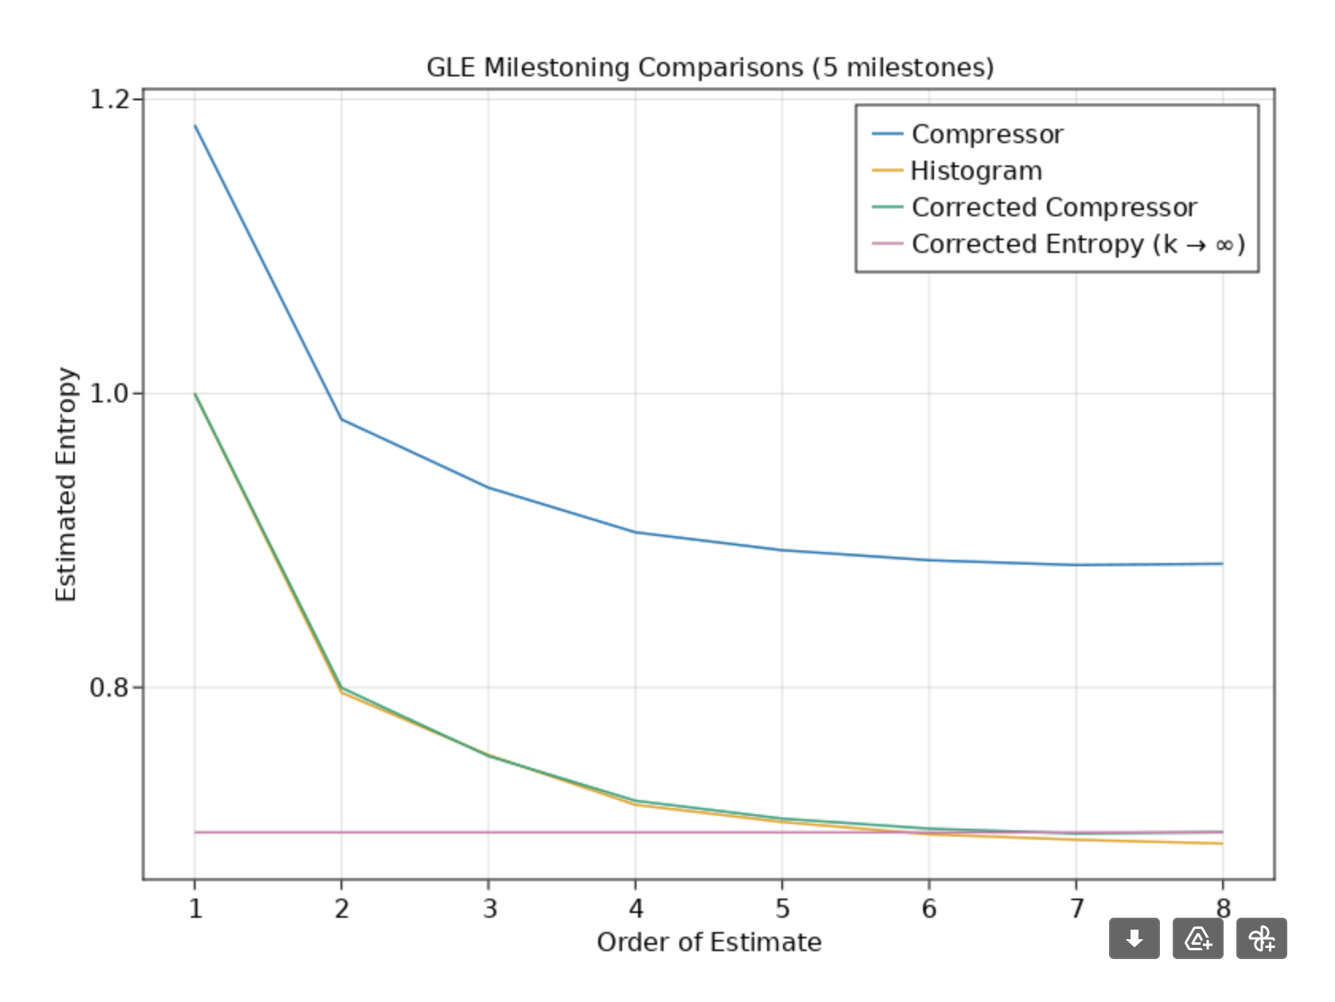
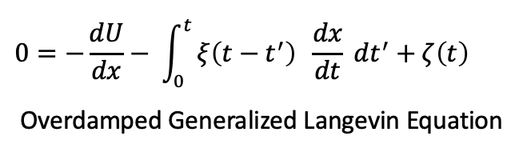
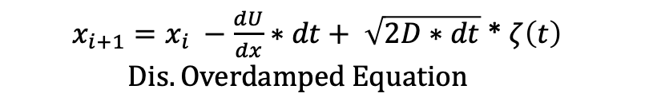
Results & Discussion
$x_{i+1}=x_{i} −\frac{dU}{dx}∗dt+ \sqrt{2D∗dt}$ * $ζ\left(t\right)$
$$Dis. Overdamped Equation$$
Notes:
Here we show case that compression can indeed distinguish and identify between non-Markov and Markov systems with some error correction.

Slide 8
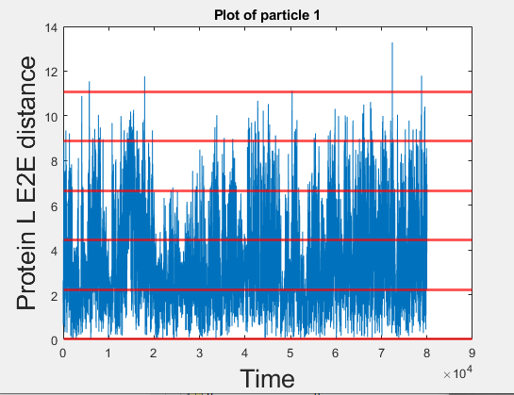
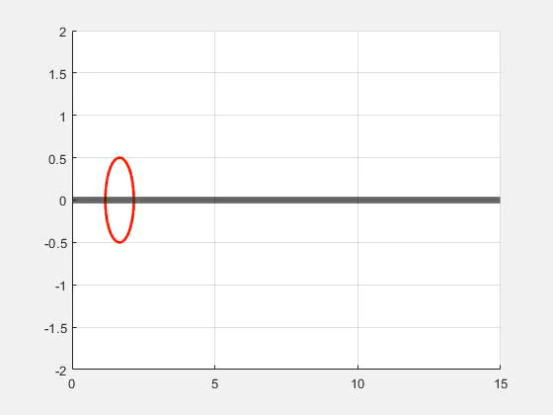
Results & Discussion
Notes:
We analyze the E2E distance of a protein which was coasr grained called Protein L, which is a protein from a bacteria and commonly used for purification of antiobodies. The major problem with using real data is that it’s quite expensive to produce these results. Hence, we just do not have enough data for this compressiong to work. However, we are still working on how to get around it by using correction on the histogram values. So, any entropy value below the actual value results in because we just do not have enough data
One can analytical solve the limit of a Brownian diffusive process of a particle moving in 1D

Slide 9
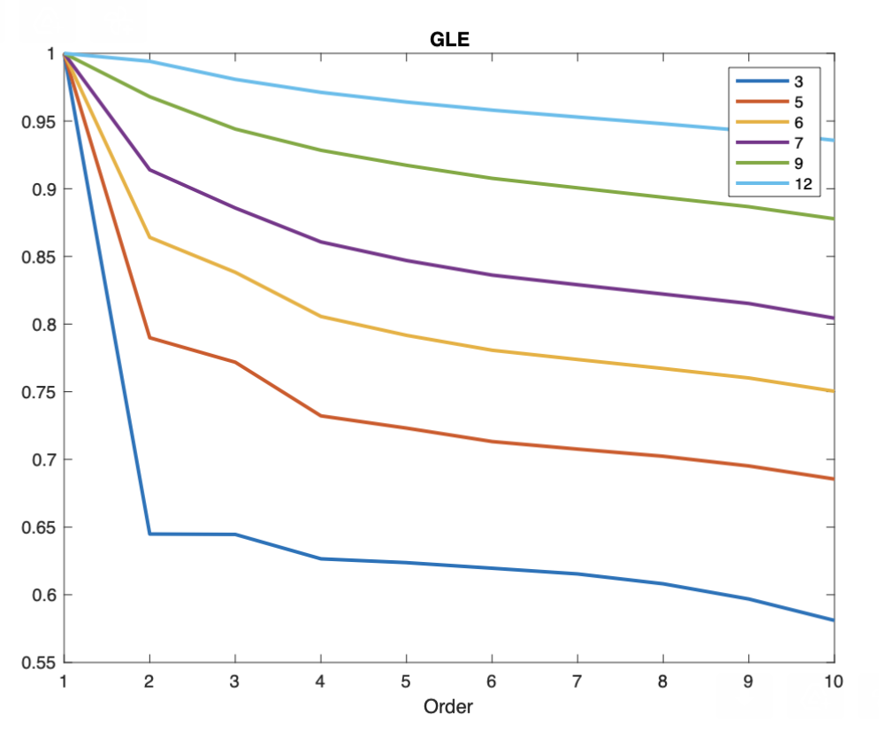
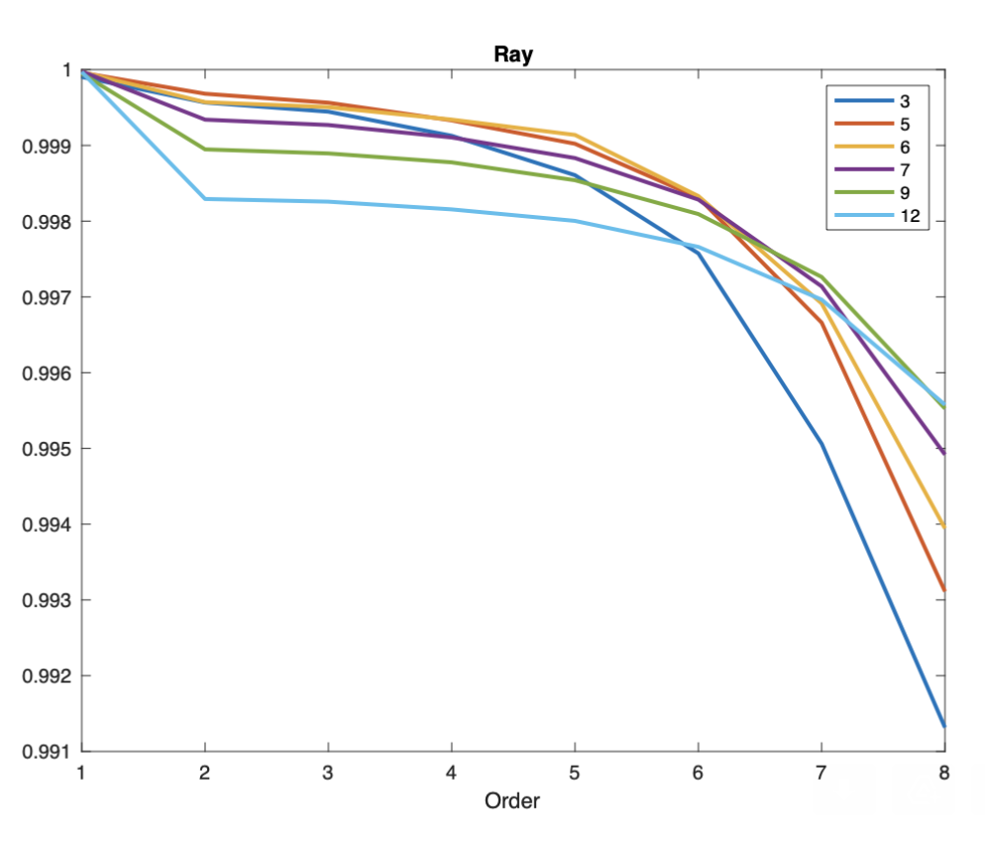
Future Work
Effect of time resolution on entropy rate
Existence of drop in entropy rate only in 2nd order
Improve time complexity of entropy calculation
Mutual entropy (Lagtime distribution and milestone crossing)
Notes:
Here we show case that compression can indeed distinguish and identify between non-Markov and Markov systems with some error correction.

Slide 10
Notes:
Here we show case that compression can indeed distinguish and identify between non-Markov and Markov systems with some error correction.

